Slide 1
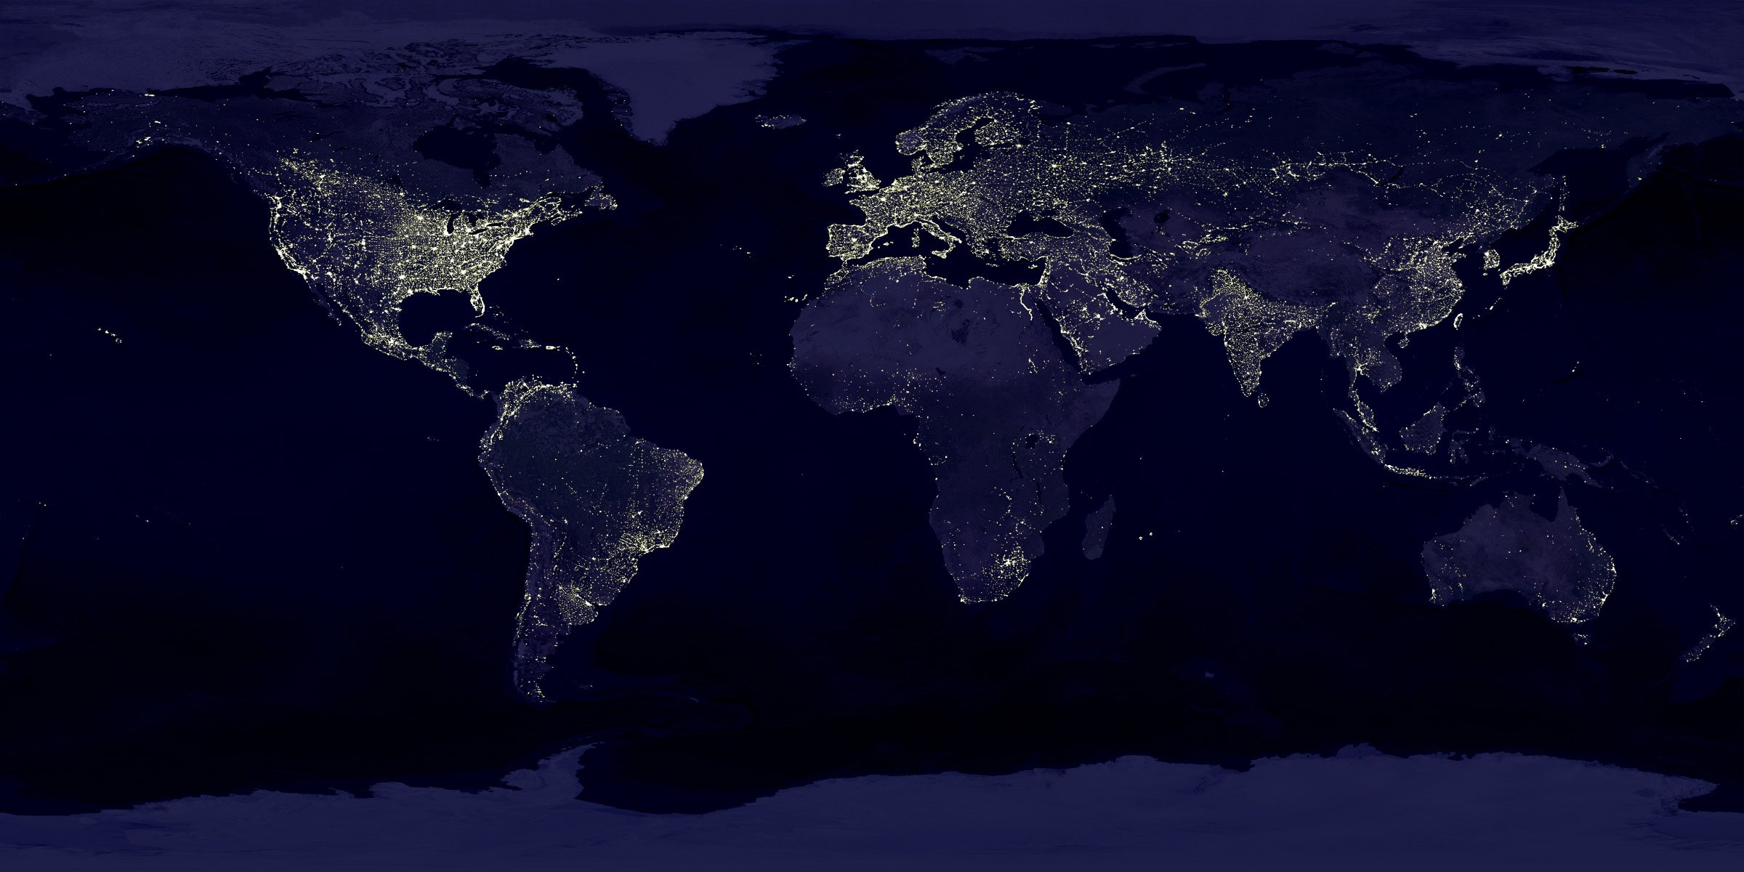
Global Life Expectancy Analysis
Group 5
Arda Cankat Bati
Qingyuan Jin
Weinan Li
Wei Zhang

Slide 2

OUTLINE
Introduction
Dataset Overview
Motivation
Differences between countries
Relevance Analysis
Change through years
Conclusion
Conclusion

Slide 3

Introduction

Slide 4

Introduction
Life Expectancy: The average period that a person may expect to live.
Live fast die young?
Problem: affected by too many variables
Harder to analyse for individuals, more
predictable for groups
Selecting variables that apply in general is
the key

Slide 5

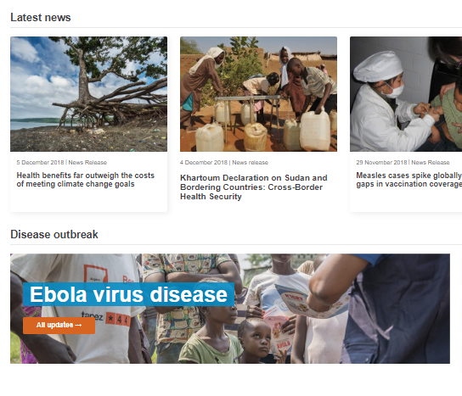
Dataset
Dataset taken from kaggle.com
Generated from the World Health Organization website
193 countries, 21 Features, between 2000 – 2015
Features: Economical, Physical, Diseases etc.
Some incomplete points, required more cleaning than normal

Slide 6

Motivation

Slide 7
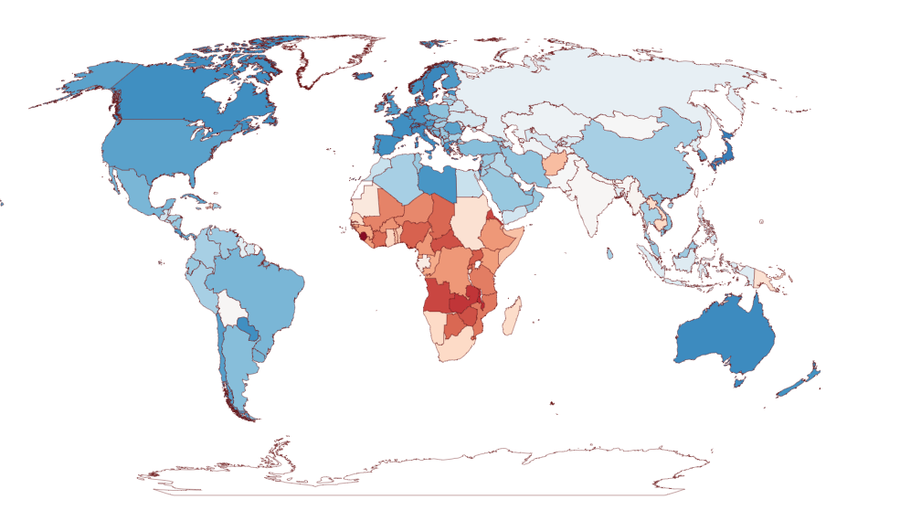
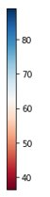
Life Expectancy in the year 2000
in years

Slide 8
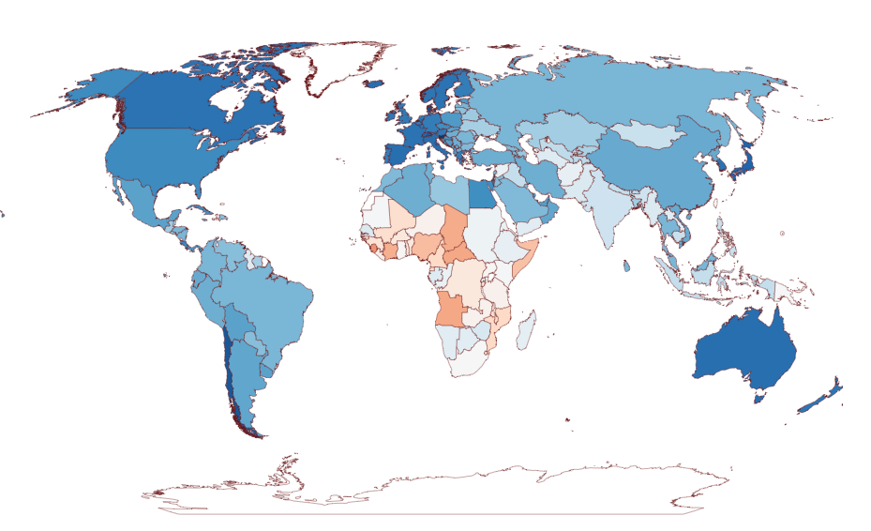
Life Expectancy in the year 2015
in years

Slide 9
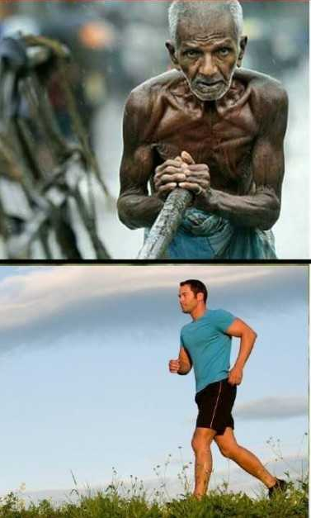
Motivation
Big difference between the countries
What features play a major role in this difference?
Factors that are most related to life exp.
Overall increasing life expectancy from 2000 to 2015
How can we keep it up?
How can the lower life exp. countries do better?
Suggestions / conclusions to paint the whole map blue

Slide 10

Difference

Slide 11
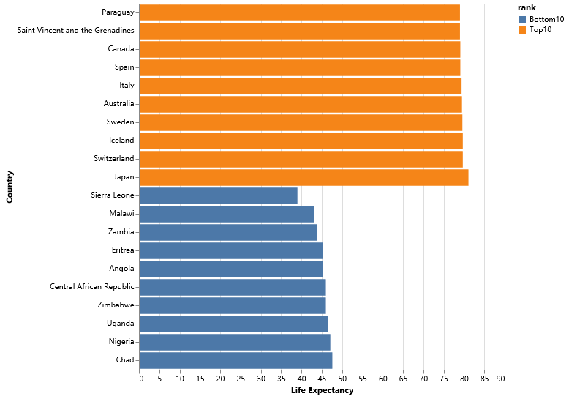
Huge gap
In 2000, Japan has a life expectancy larger than twice of Sierra Leone.
People in top10 countries averagely live 40 years longer than people in the bottom countries.

Slide 12
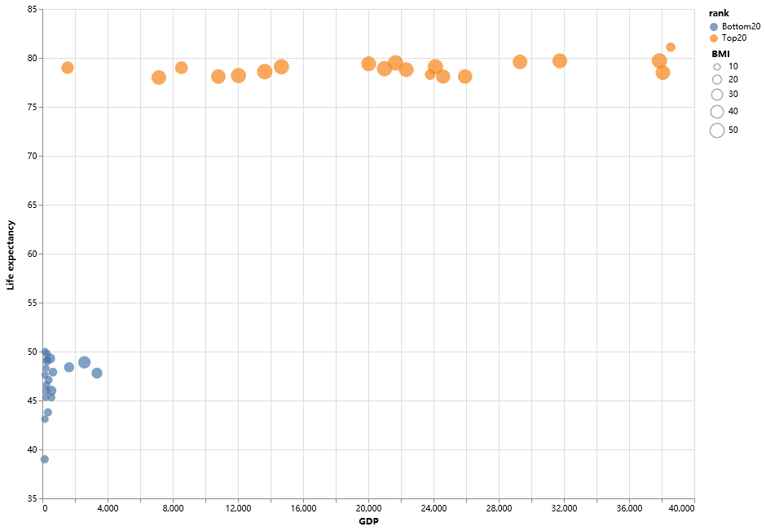
Why?
Higher BMI cause health problem?
In poor countries, people don’t even have enough food.

Slide 13
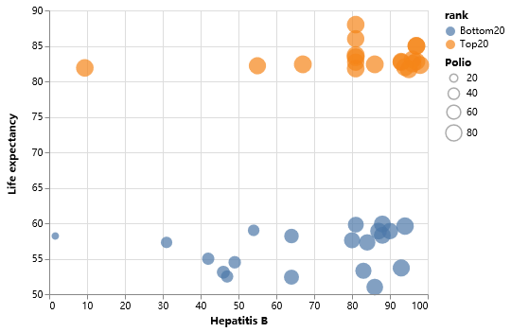
Why?
Despite having similar coverage of some vaccines, poor countries are still suffering.

Slide 14
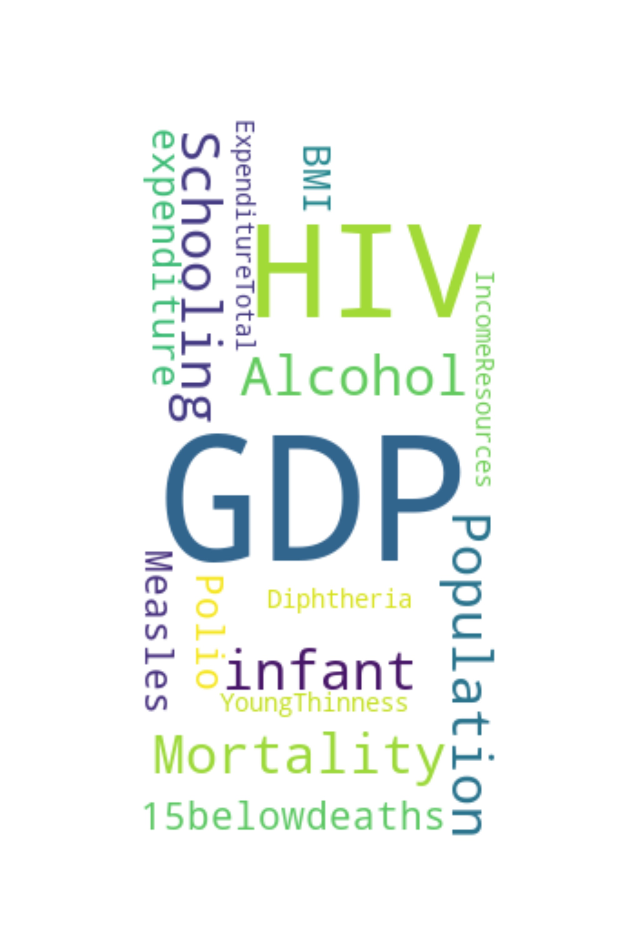
Relevance
Analysis

Slide 15


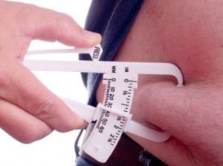
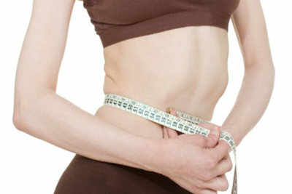
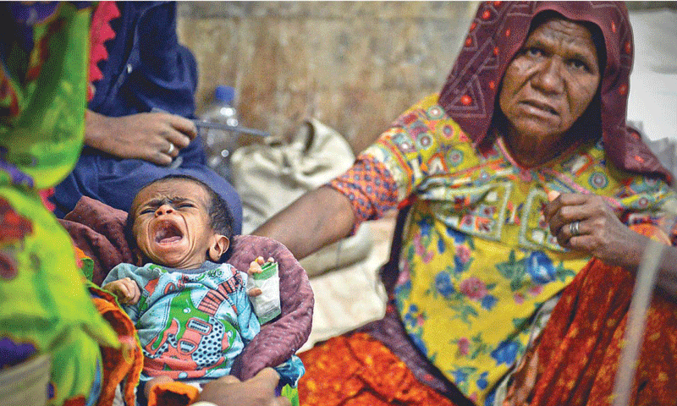

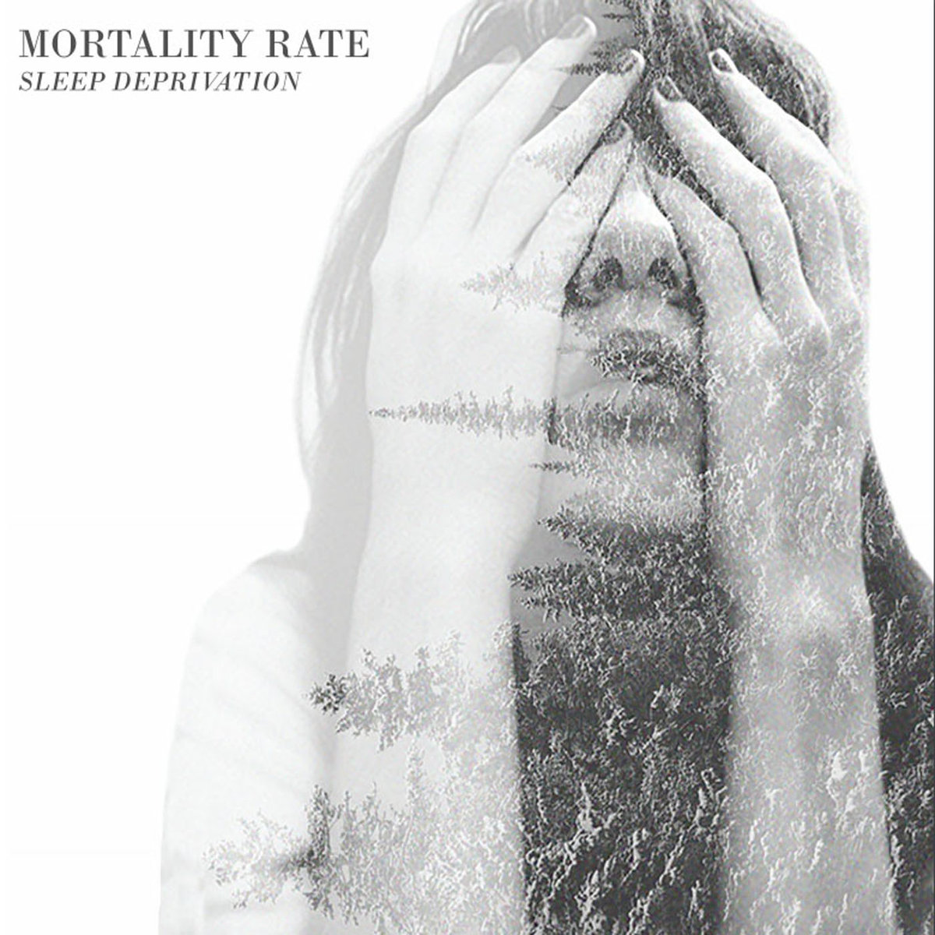



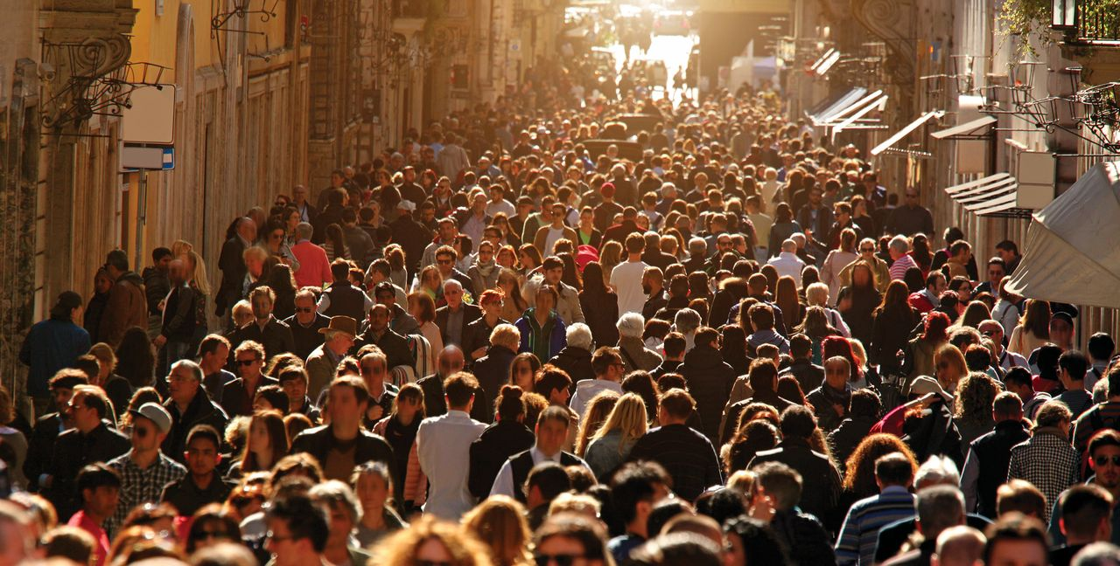


19 Features
 

Slide 16
PCA
Goal
Select most relevant features
Narrow down our target
6 most relevant Feature
GDP
HIV
Hepatitis B
Adult Mortality
Income resources
Schooling

Slide 17
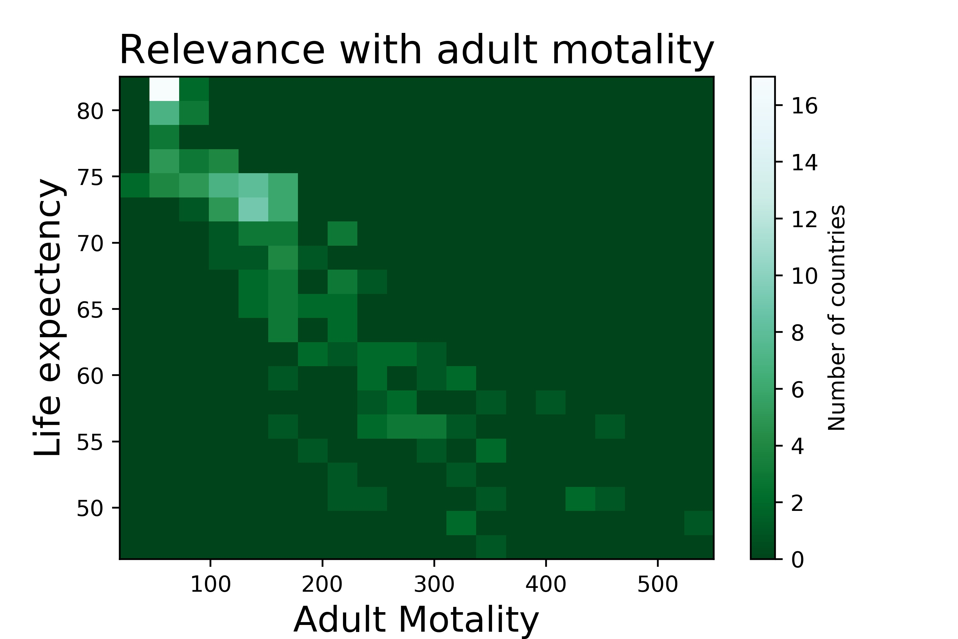
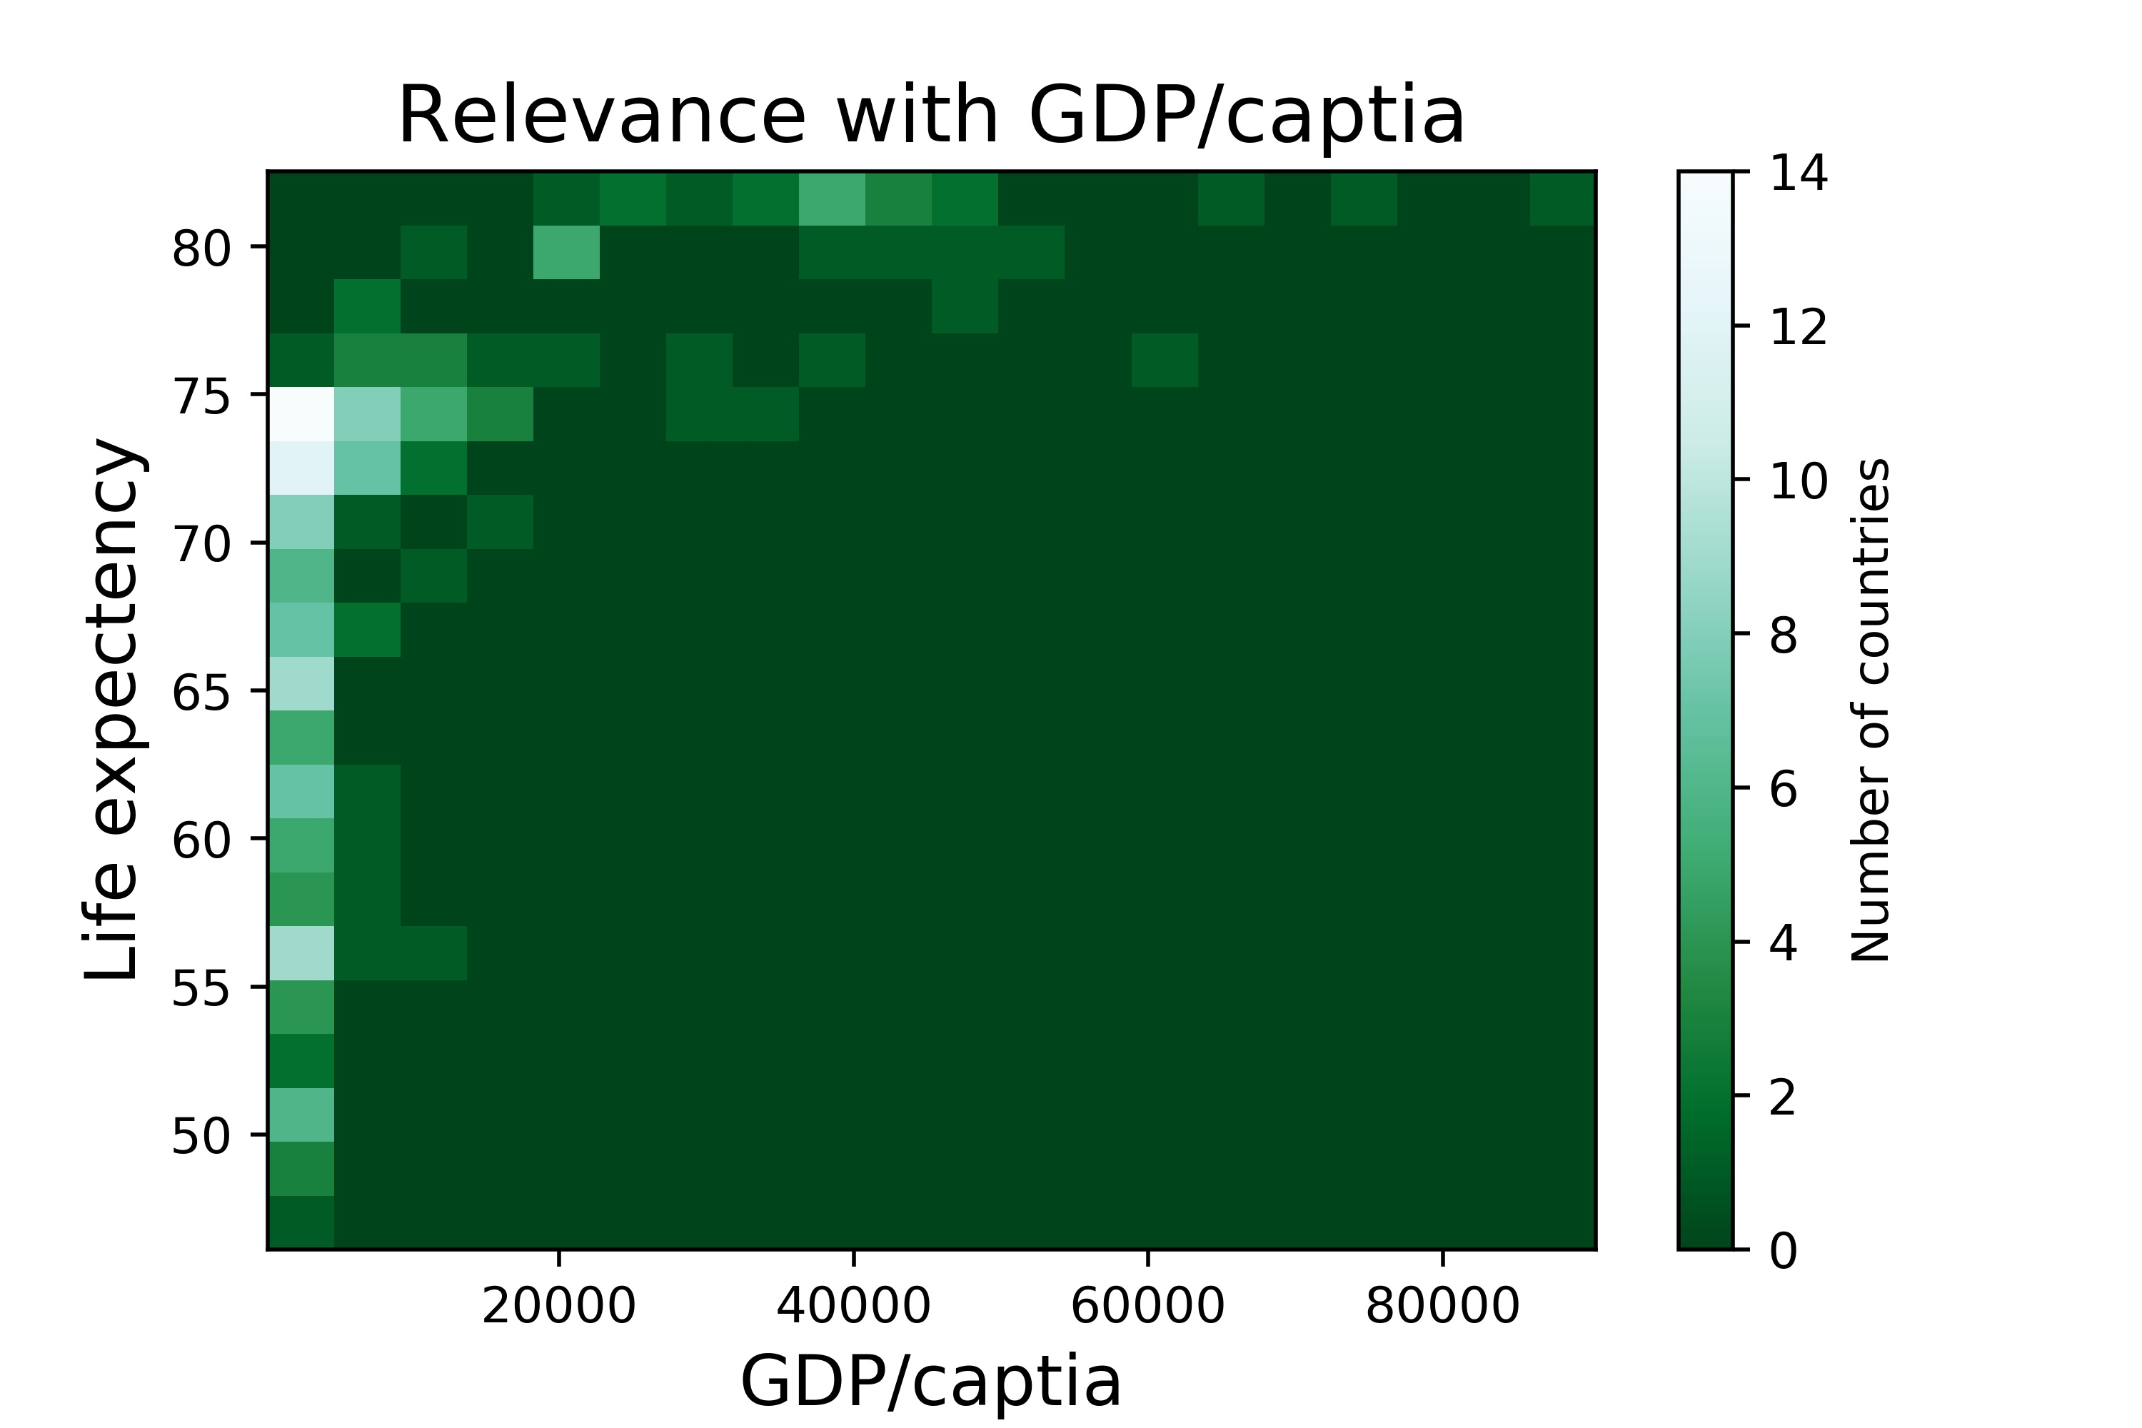

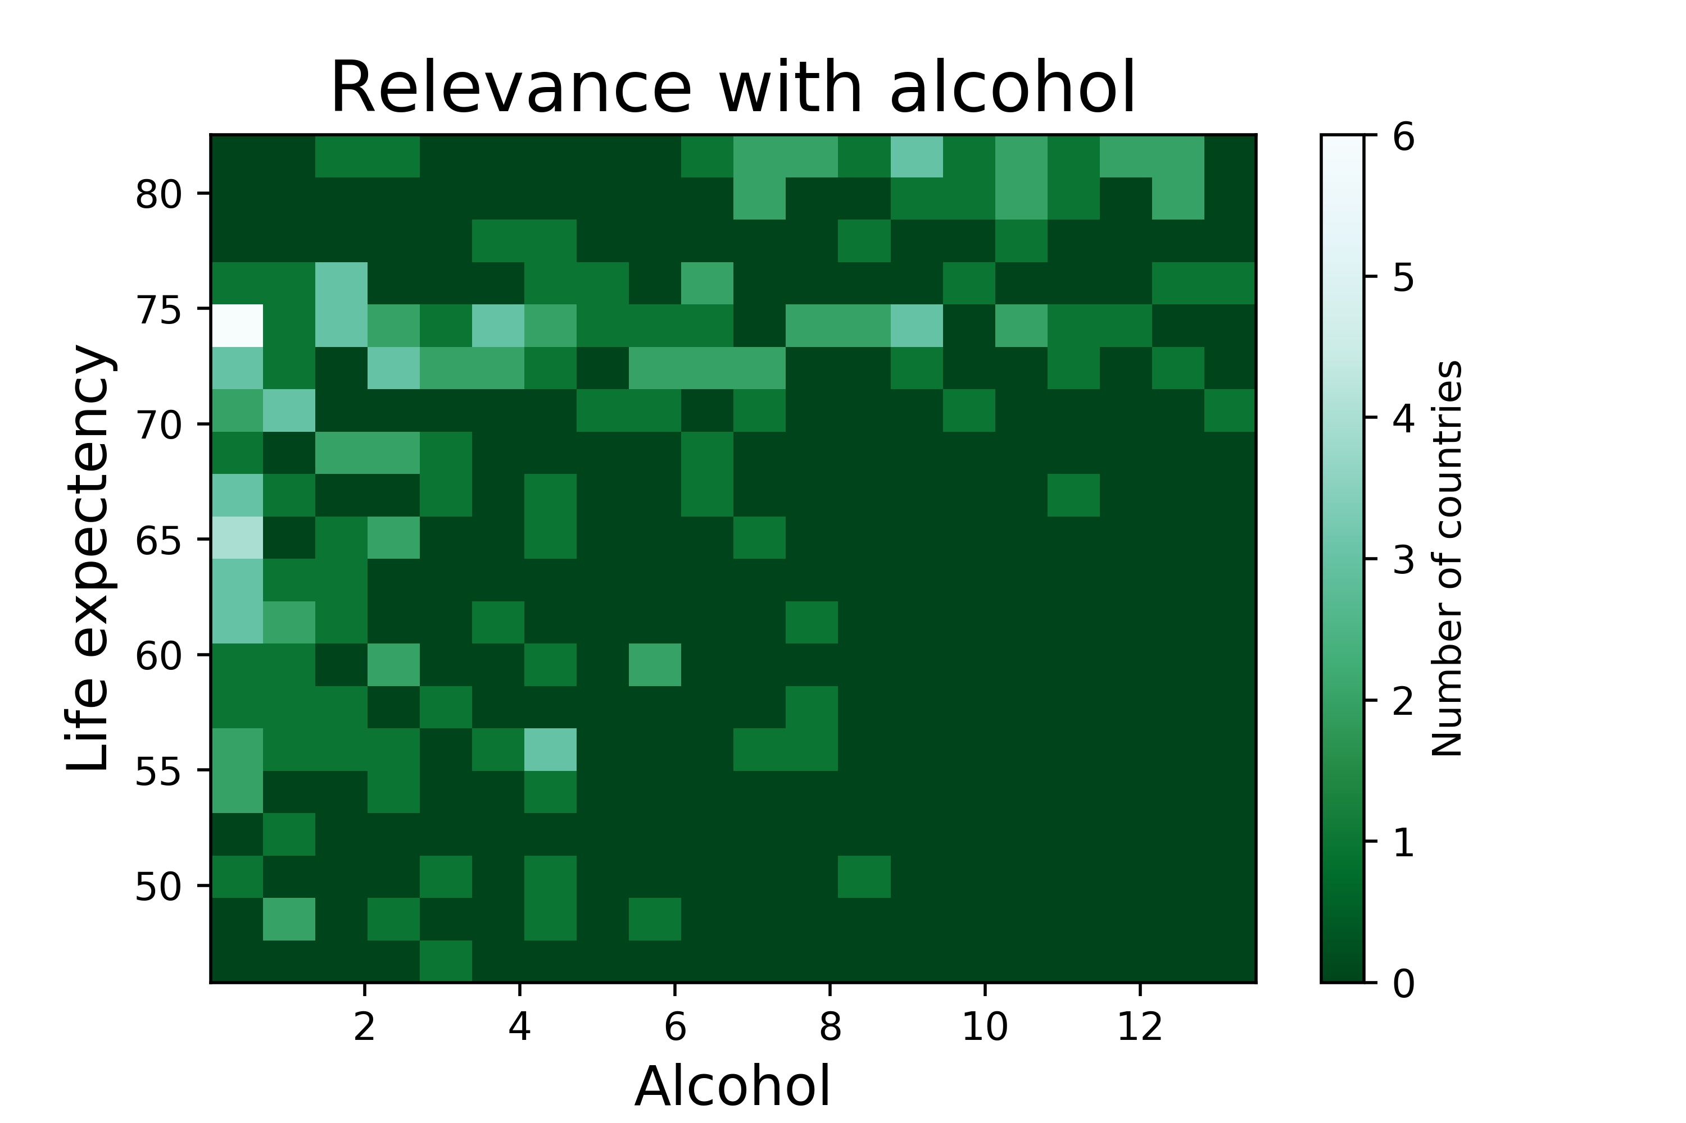
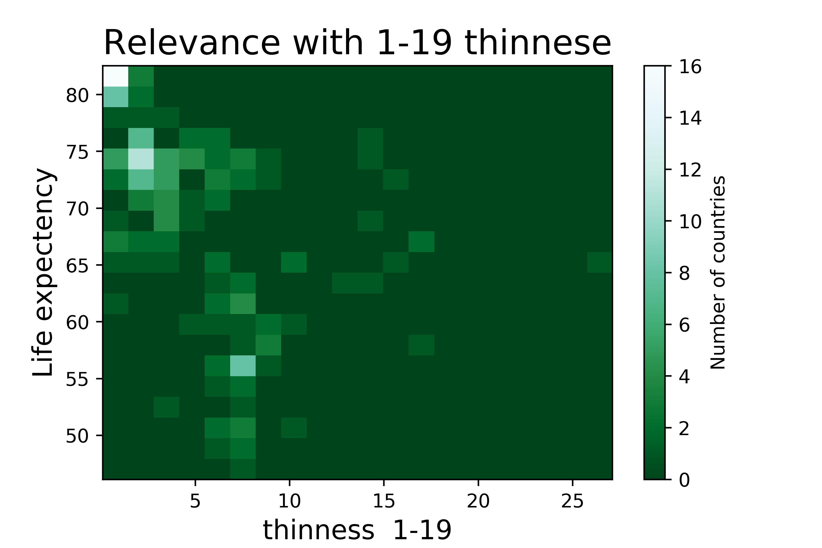

PCA

Slide 18
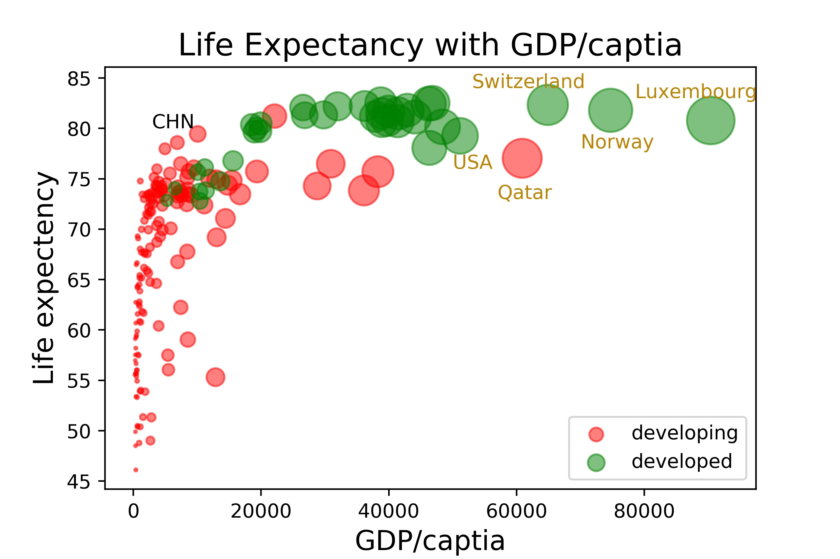
GDP!!!
Larger spots, higher GDP/captia
Life expectancy is positive relevant with GDP/cap
Developed countries is richer than developing ones, so they have longer life
Northern Europe countries
Developing countries

Slide 19
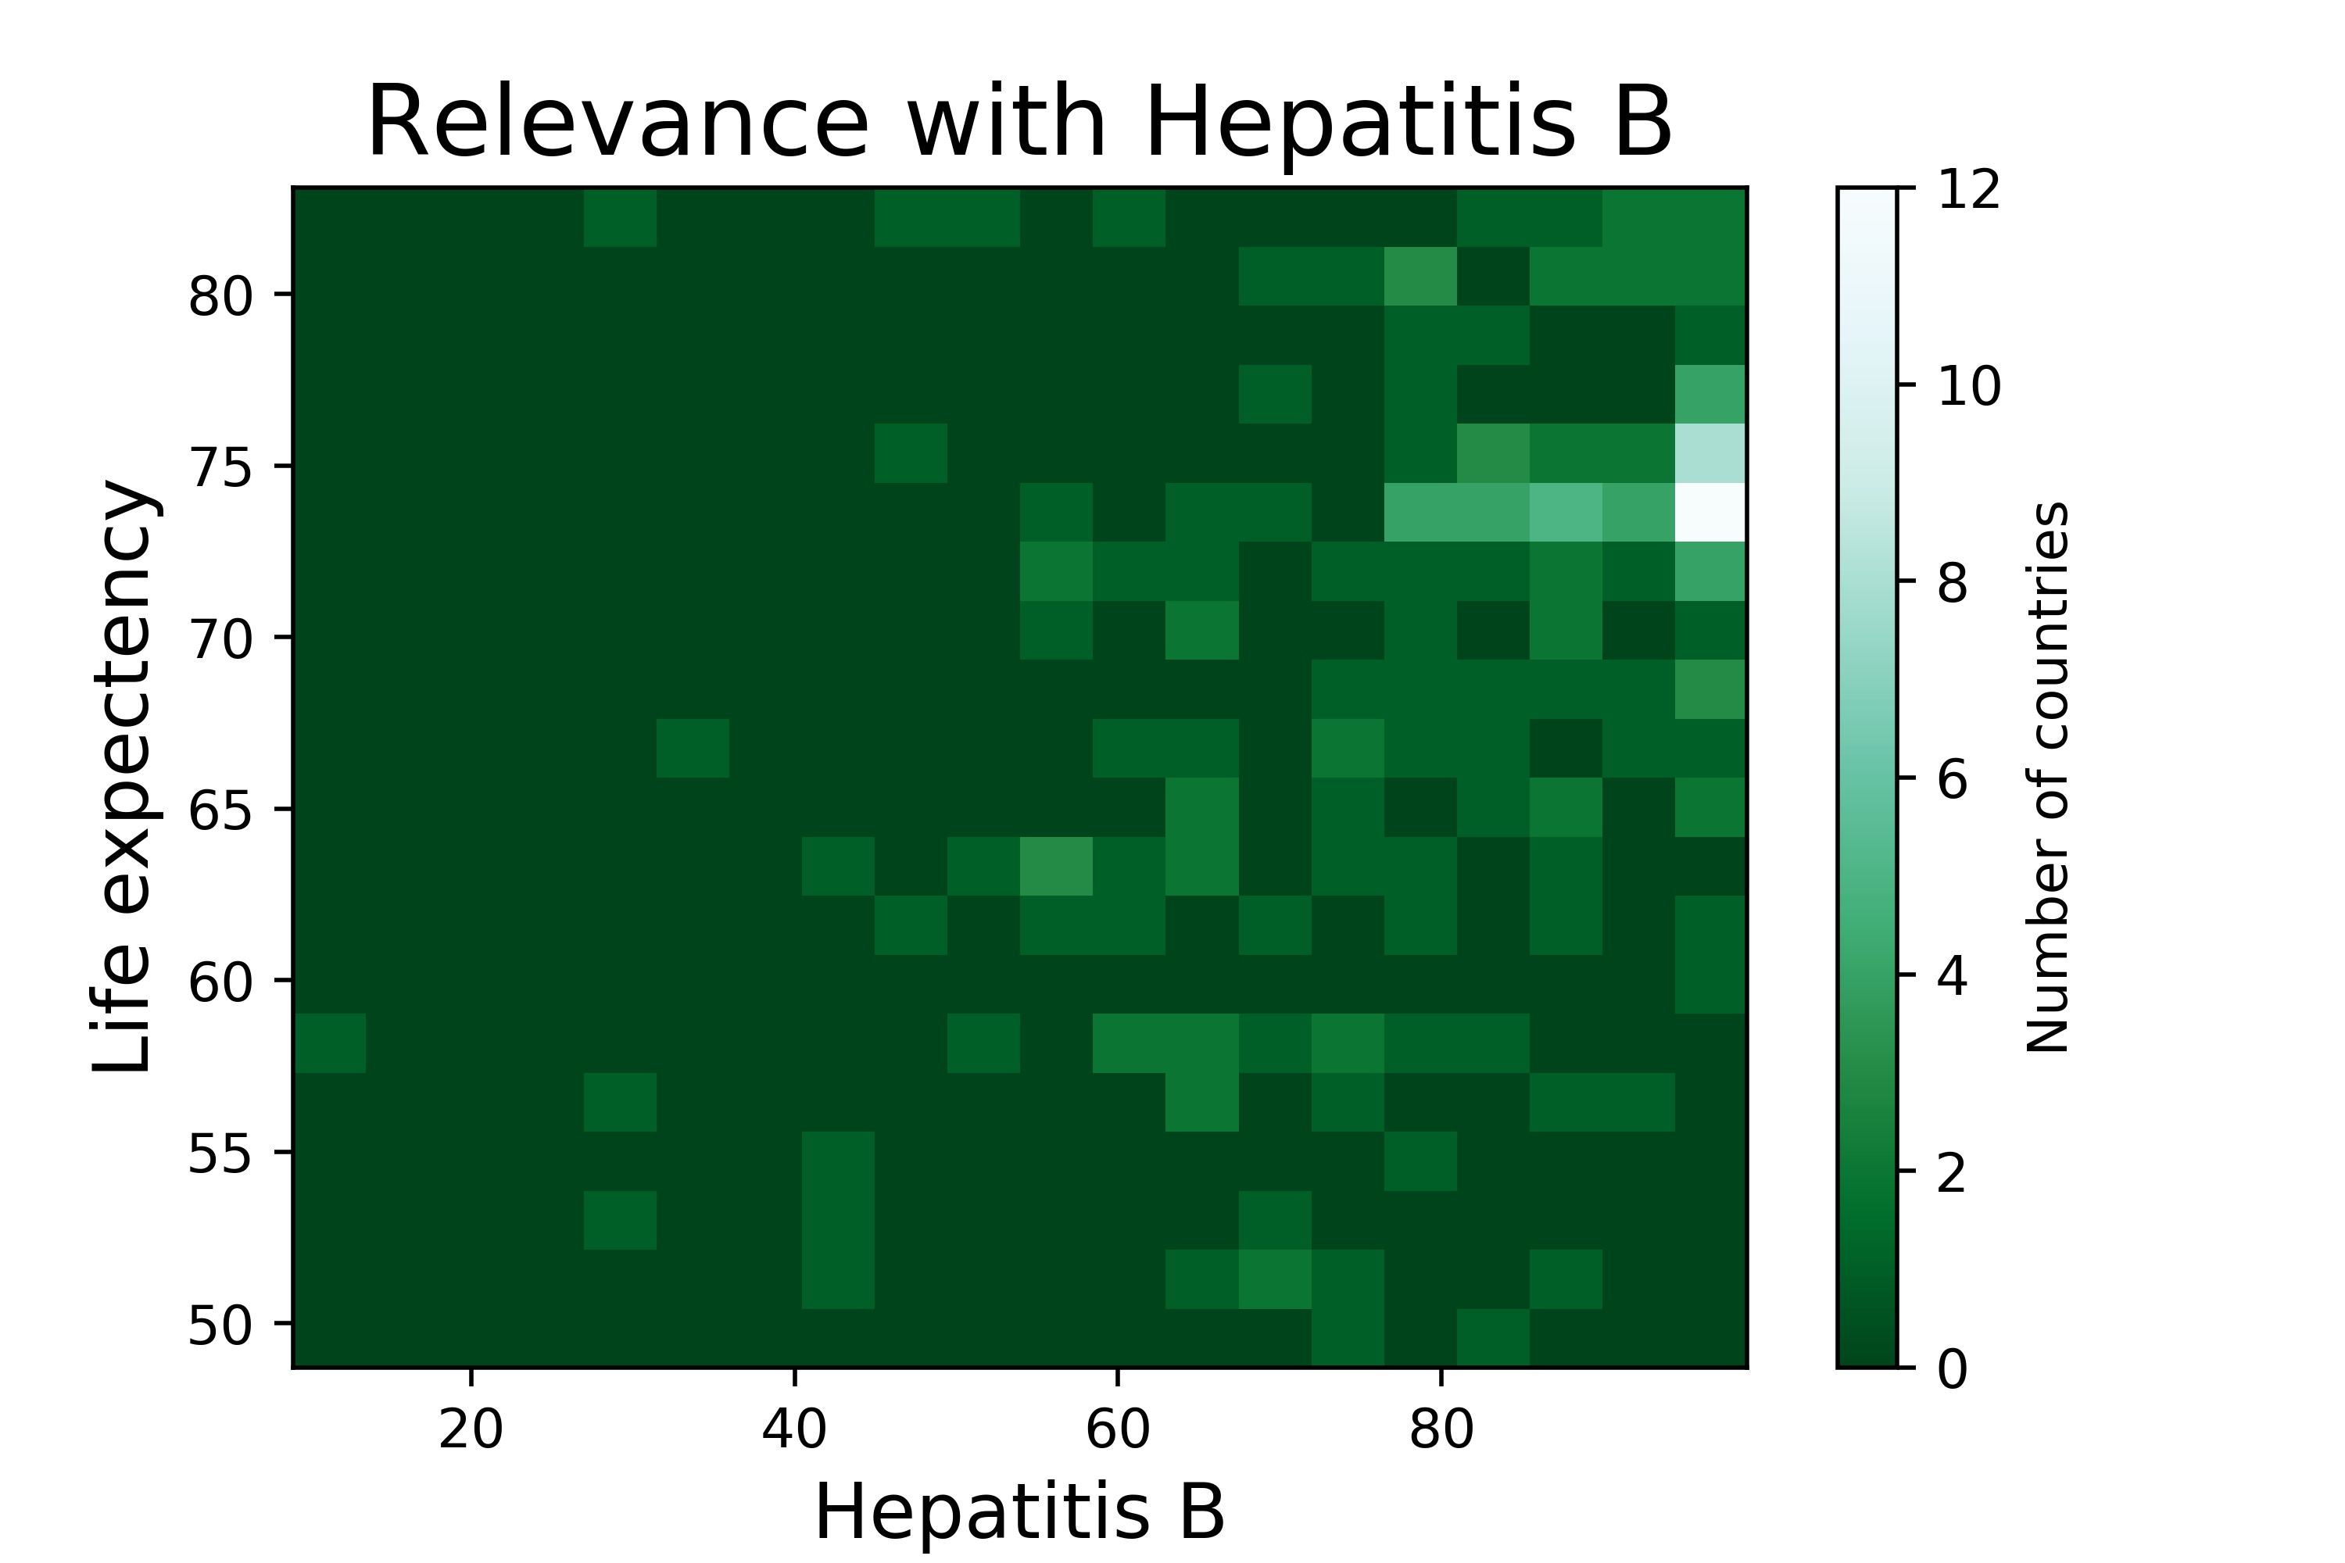
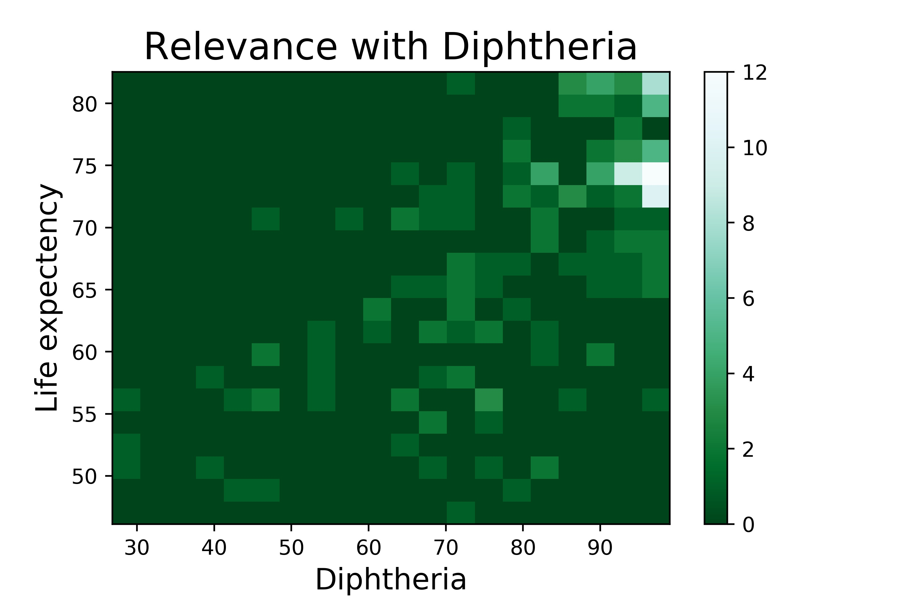
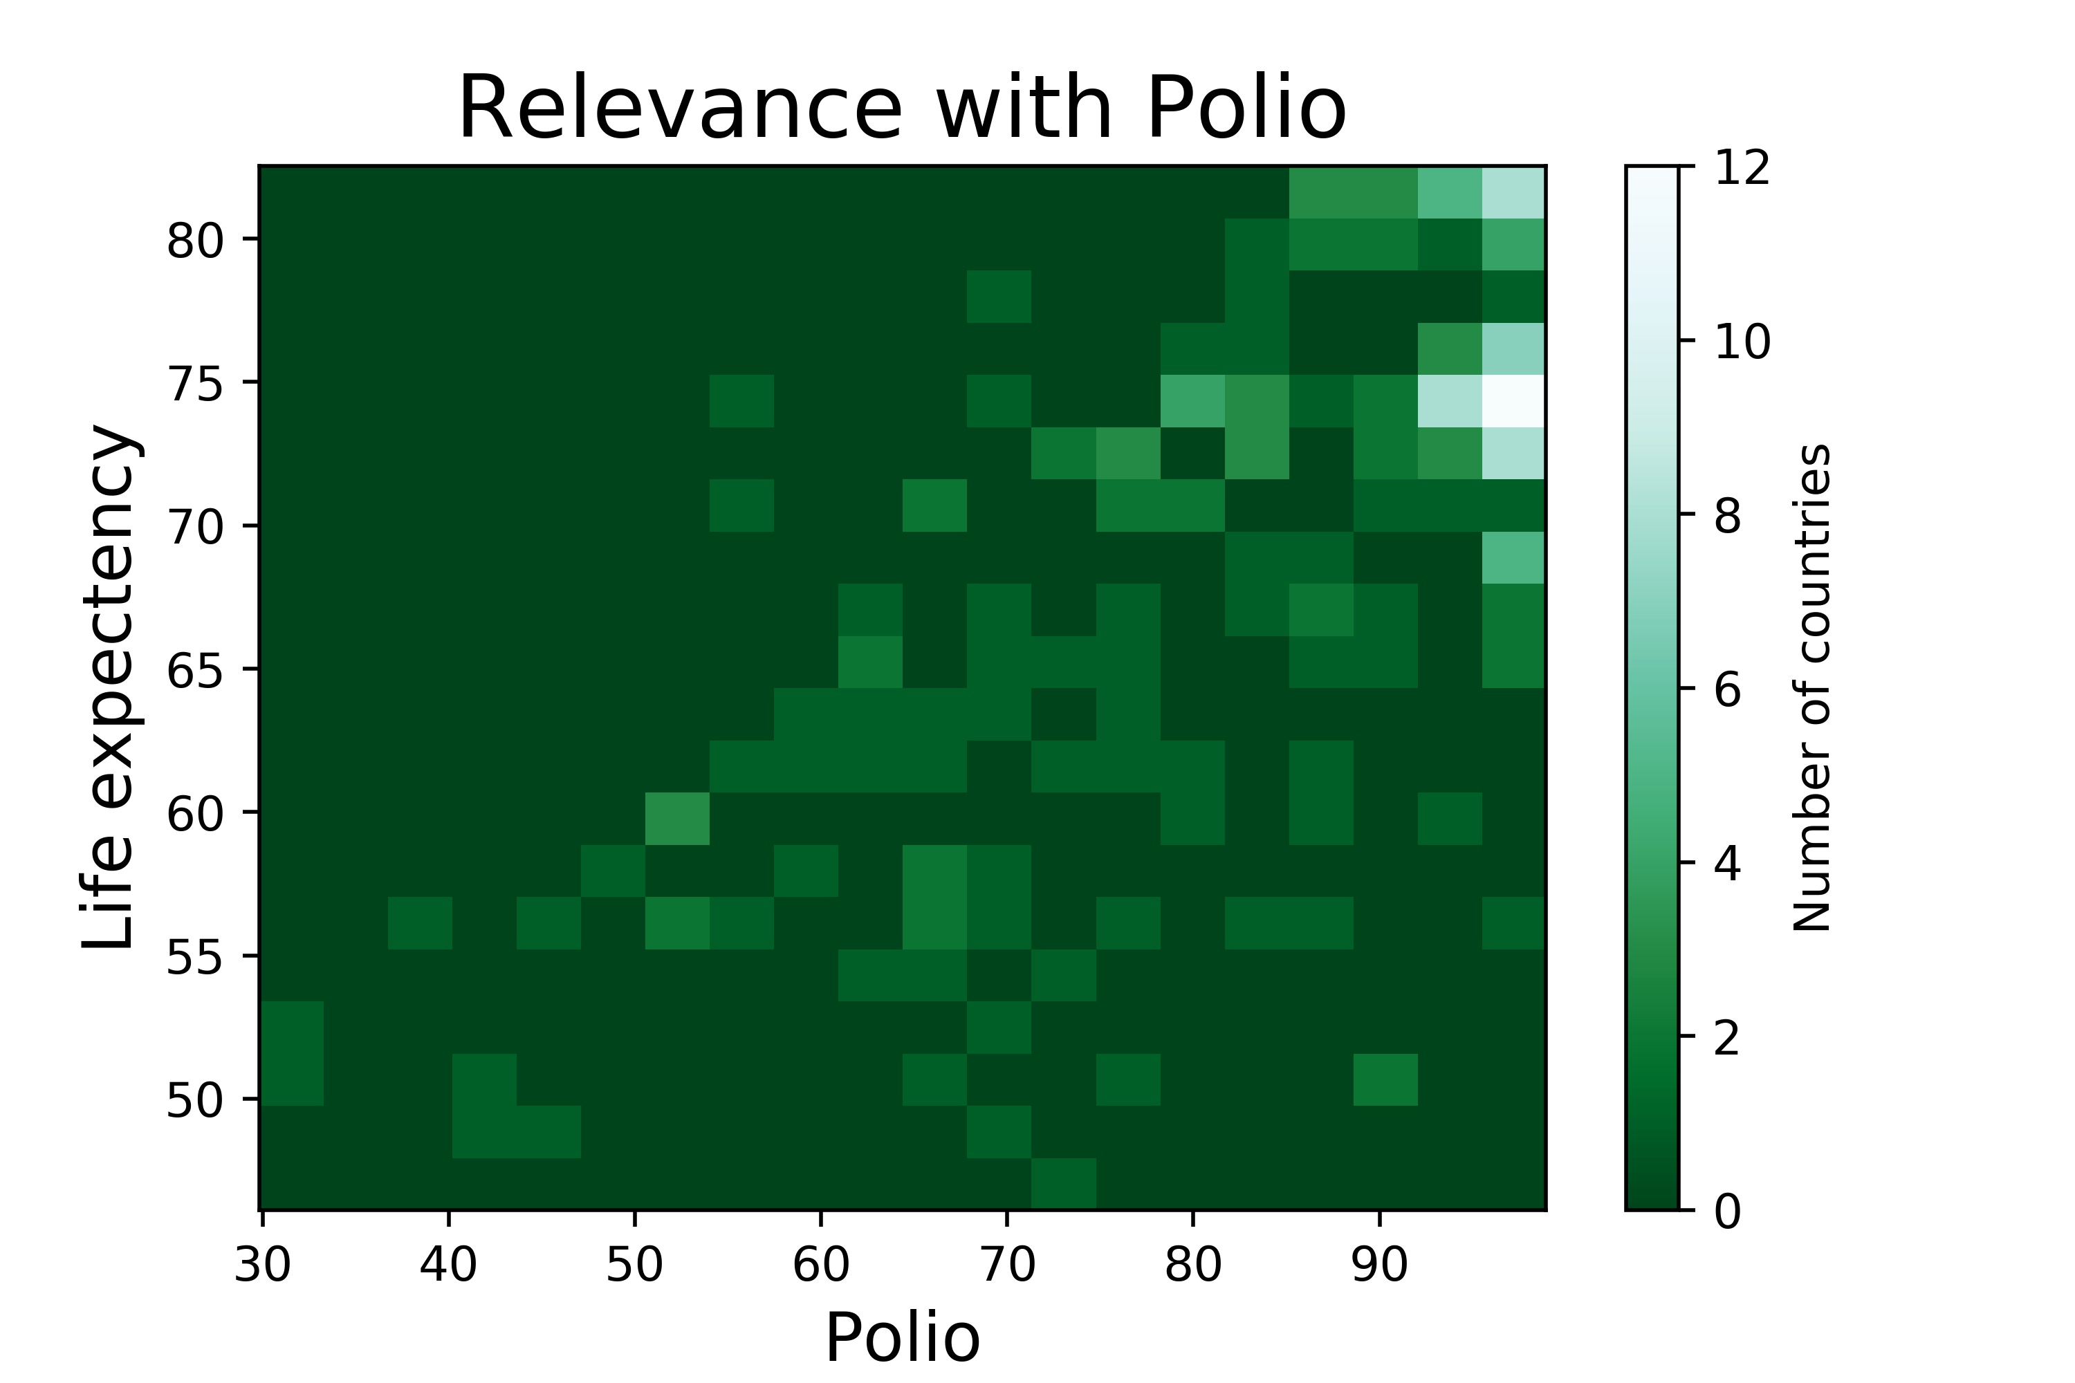
Roughly higher vaccine injection rate, higher life expectancy
They have almost the same relevance
Go with CDP
Vaccine

Slide 20

Change
through
years

Slide 21
Overall

Slide 22
Fastest changing countries

Slide 23
Top10 VS Overall

Slide 24
Top10 VS Overall

Slide 25
Most significant

Slide 26
Conclusion

Slide 27



Conclusion
1. Most relevant features
2. highest changing features
3. More research into underlining relevance between features and life expectancy

Slide 28
THANK YOU

